Slide 1


PRESENTATION ON
Face Mask Detection Based Automate Door Lock During Pandemic
By
Aditya Singh -18202
Gaurav Sharma -18223
Manish Rai -18228
Shubham Singh -18246
Guided by – Dr. Siksha Jain
Submitted to the Department of Electronics and Communication Engg.
in partial fulfillment of the requirements
for the degree of
Bachelor of Technology
in
Electronics and Communication Engineering
INSTITUTE OF ENGINEERING & TECHNOLOGY
DR. RAMMANOHAR LOHIA AVADH UNIVERSITY,AYODHYA (U.P)

Slide 2
Face Mask Detection Based Automatic Door Lock During Pandemic

Slide 3
Table of Content
INTRODUCTION
PROJECT PROPOSAL AND SCOPE
SOFTWARE / SYSTEM REQUIREMENT SPECIFICATION
BLOCK DIAGRAM , CIRCUIT DIAGRAM
TENTATIVE COST , ADVANTAGES
RESULTS
FUTURE SCOPE
REFERENCE

Slide 4
INTRODUCTION
Our country is densely populated where, some people are alert and aware , while some are careless and We can not put everyone’s life in danger on their innocence .
Covid-19 Pandemic is not over yet and we all are well aware of this deadliest tragedy ever.
During this COVID-19 pandemic the mask plays a vital role in preventing the people from the spread of the disease . Even before this pandemic some industries like chemicals industries, paint industries, cotton industries , etc. Masks are the important thing to prevent the individual life from various diseases.
We are currently focusing on the prevention of spread of COVID-19 in public places like ATM’S where people did not wear the mask and spread or being infected by the virus. It’s complex task if we use a human power to monitor the individuals in the public as well as high cost too.

Slide 5



Slide 6
PROJECT PROPOSAL AND SCOPE
Wearing mask plays a major role in this current pandemic situation and we know that it is the only way to prevent yourself from the virus but many of us don’t care about this.
People now roaming in the public places like ATM’s, malls, etc., without wearing mask. The government also can’t able to monitor each of them individually.
And not only in this pandemic situation in general mask kind of protective equipment’s are mandatory to work in industries those having toxic environment or those cause a health issue in a long term. But both the workers and the organization didn’t care about that. So, to monitor this we are going to give a solution with the of- Face Mask Detection Based Automatic Door Lock System .
An IoT-enabled smart door is developed to detect face masks that can enhance public safety. This will help to reduce manpower while also providing an extra layer of protection against the spread of Covid-19 infection.

Slide 7

So, we are providing a solution using the : Face Mask Detection Based Automate Door Lock System
In a simple word if an individual wearing a mask means he/she will be allowed to enter otherwise the door will not open.

Slide 8


SOFTWARE / SYSTEM REQUIREMENT SPECIFICATION COMPONENTS USED IN THIS PROJECT
185,244 users
100%
HARDWARE
SOFTWARE
ESP32-CAM Wi-Fi
Arduino IDE 1.8.19
Arduino UNO
Teachable Machine
MG995 Servo Motor
16x2 I2C LCD
USB to TTL Serial Converter
Green LED, Red LED
Jumper wire & Breadboard

Slide 9
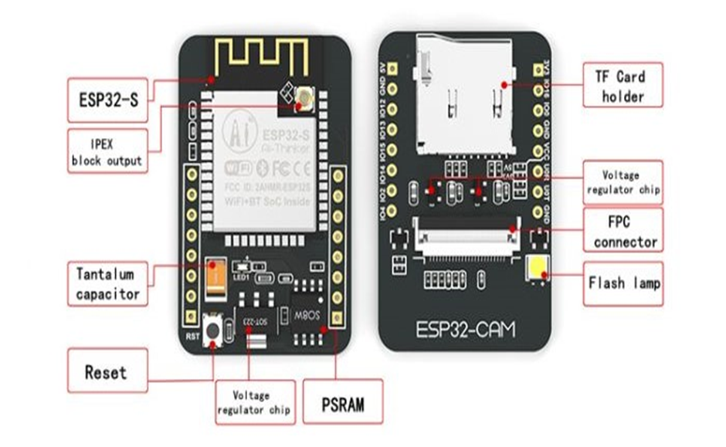
ESP32-CAM WIFI
The ESP32-CAM is a small size, low power consumption camera module based on ESP32. It comes with an OV2640 camera and provides onboard TF card slot.
The ESP32-CAM can be widely used in intelligent IoT applications such as wireless video monitoring, Wi-Fi image upload, QR identification, and so on.
Onboard ESP32-S module, supports Wi-Fi + Bluetooth
OV2640 camera with flash
Onboard TF card slot, supports up to 4G TF card for data storage
Supports Wi-Fi video monitoring and Wi-Fi image upload

Slide 10

ARDUINO UNO
An Arduino is a tiny computer that you can program to process inputs and outputs going to and from the chip.
It can be powered and programmed using a computer or mobile phone. Arduino contains a mini/micro or type B USB port that can be used to connect to a PC via the regular USB port, and the connection is done via a USB cable. Used in Programmable robots
Arduino Uno is a popular microcontroller development board based on 8-bit ATmega328P microcontroller.
Along with ATmega328P MCU IC, it consists other components such as crystal oscillator, serial communication, voltage regulator, etc. to support the microcontroller.

Slide 11
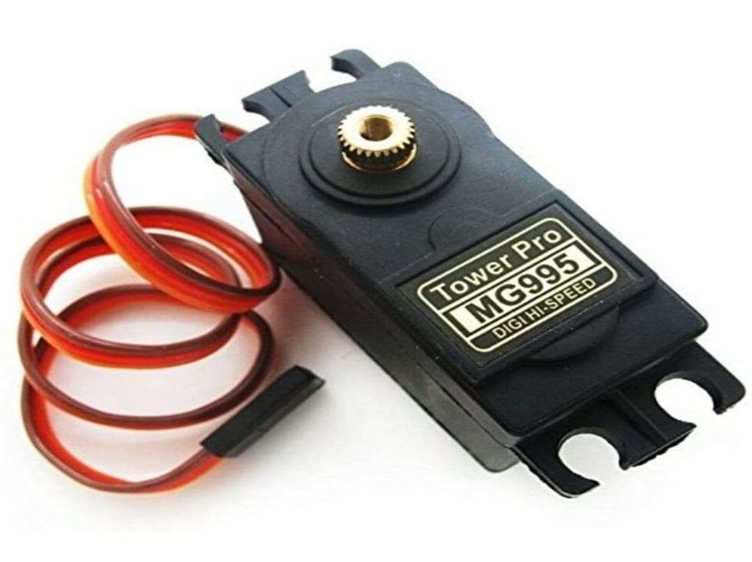
MG995 Servo Motor
A servo motor is an electrical device which can push or rotate an object with great precision.
Servos are mainly used on angular or linear position and for specific velocity, and acceleration.
The servo is used in drones and toy planes. Having a satisfying torque which is enough to overcome air resistance and control wings of plane, the servo is preferred in toy planes and drones which need precision control no matter the condition.

Slide 12
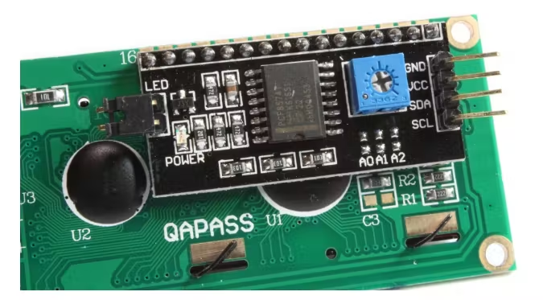
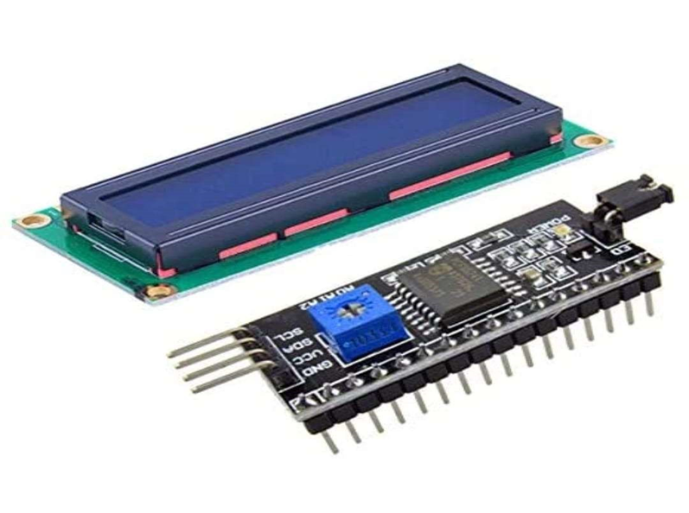
16x2 I2C LCD
This is LCD 16x2 Parallel LCD display that provides a simple and cost-effective solution for adding a 16×2 Liquid Crystal Display into your project. The display is 16 character by 2 line display has a very clear and high contrast
LED colour for backlight is green or blue
By using I2C module, LCD can be interfaced with using only 2 wires.
It only need 4 pins for LCD display: VCC,GND,SDA,SCL

Slide 13
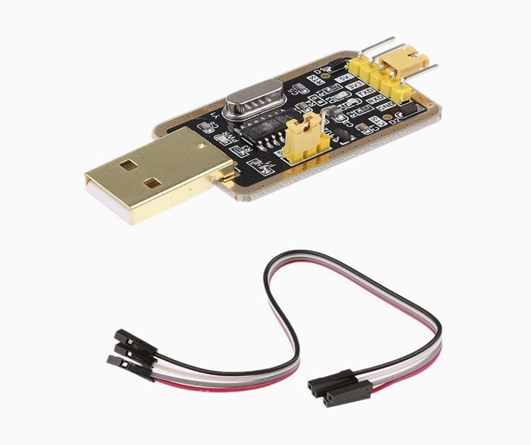
USB to TTL Serial Converter
It's a small USB to TTL serial tool, using the CH340G chip. You can use it to connect some serial device to your PC via USB port.
Designed to be used for USB to TTL electronic projects. Built-in USB to TTL Transfer chip. TTL interface output, easy to connect to your MCU.
Dual 3.3V and 5V Power output, work with 3.3v and 5v target device

Slide 14
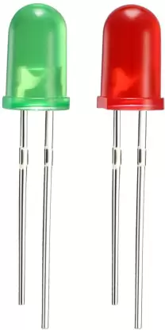
Light Emitting Diode
A Light Emitting Diode (LED) is a special type of PN junction diode. The light emitting diode is specially doped and made of a special type of semiconductor. This diode can emit light when it is in the forward biased state.
In this project we use GREEN LED to indicate Facemask is detected & door is open.
RED LED to indicate Facemask is not detected & door is close.

Slide 15
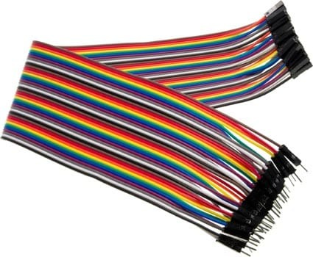
Jumper wire
Jumper wire is an electrical wire that used to connect two devices in an easy way.
It helps device to connect each other without soldering.
Jumper wires are mainly used in the breadboard connections to make any changes in a easy way.
Although jumper wires come in a variety of colours, they do not actually mean anything. The wire colour is just an aid to help you keep track of what is connected to which.

Slide 16
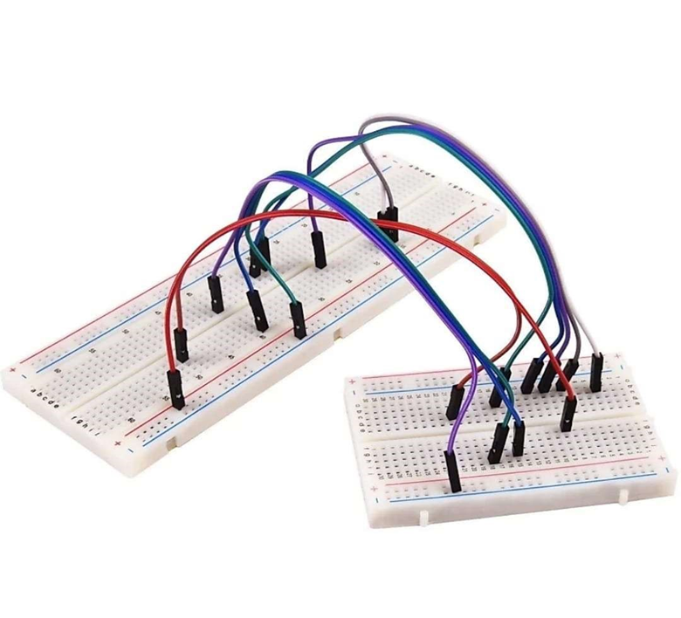
Breadboard
A breadboard is also known as a solderless board because the component used on the breadboard does not need any soldering to connect to the board, so it can be reused.
The connection on the breadboard is not permanent but they can be connected without soldering the components.
If you make any mistake while connecting the components, you can place or remove the components effortlessly. For beginners of electronics, this device is very helpful to make mini-projects.

Slide 17
Arduino IDE
An official software introduced by Arduino.cc, that is mainly used for writing, compiling and uploading the code in almost all Arduino modules/boards.
Arduino IDE is open-source software and is easily available to download & install from Arduino's Official Site.
This environment supports both C and C++ languages.
It is available for all operating systems i.e. MAC, Windows, Linux and runs on the Java Platform that comes with inbuilt functions and commands that play a vital role in debugging, editing and compiling the code.
The IDE environment mainly contains two basic parts: Editor and Compiler where former is used for writing the required code and later is used for compiling and uploading the code into the given Arduino Module.

Slide 18
Teachable Machine
Teachable Machine is a web-based tool that makes creating machine learning models fast, easy, and accessible to everyone.
The Teachable Machine is an effort by Google to make Machine Learning and AI accessible to the wider public.
In this project , I’m going to walk you through making a machine learning model to detect person wearing facemask or not
I’m going to make two classes here - one with facemask, and other without facemask.
1. With Mask
2. Without Mask

Slide 19
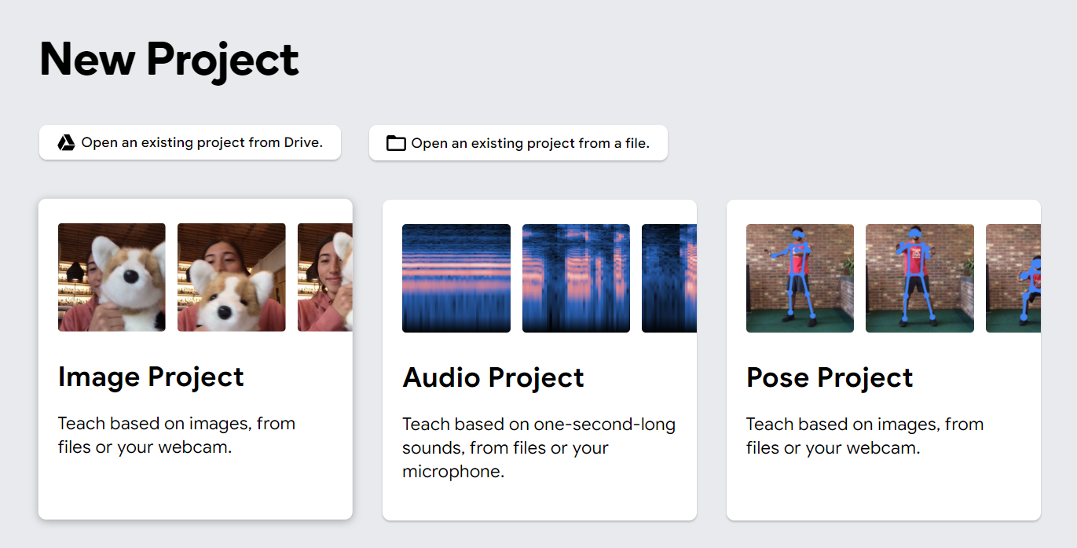
So to get started, I’ll go to Teachable Machine and open up an image project.

Slide 20
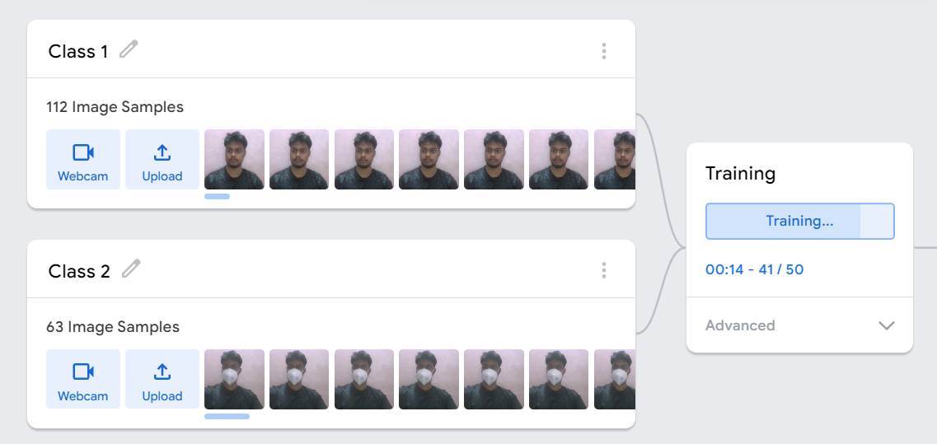
Fig : Teachable Machine Class

Slide 21
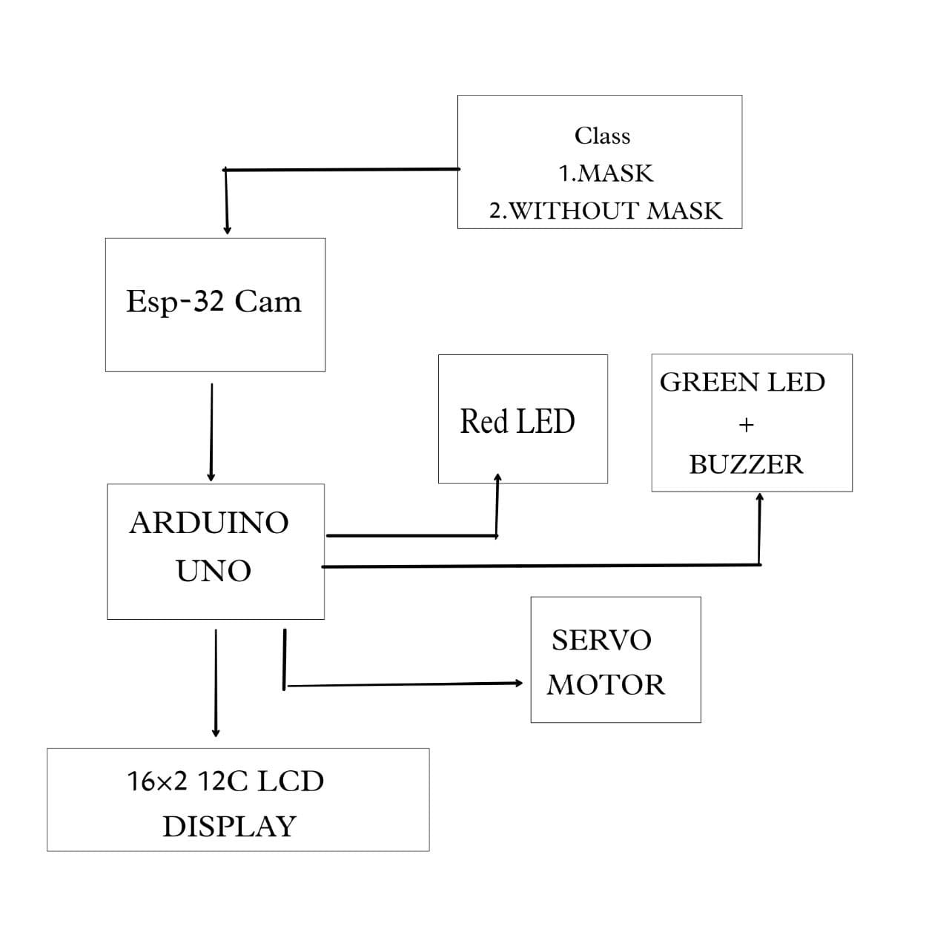
BLOCK DIAGRAM
Teachable Machine

Slide 22

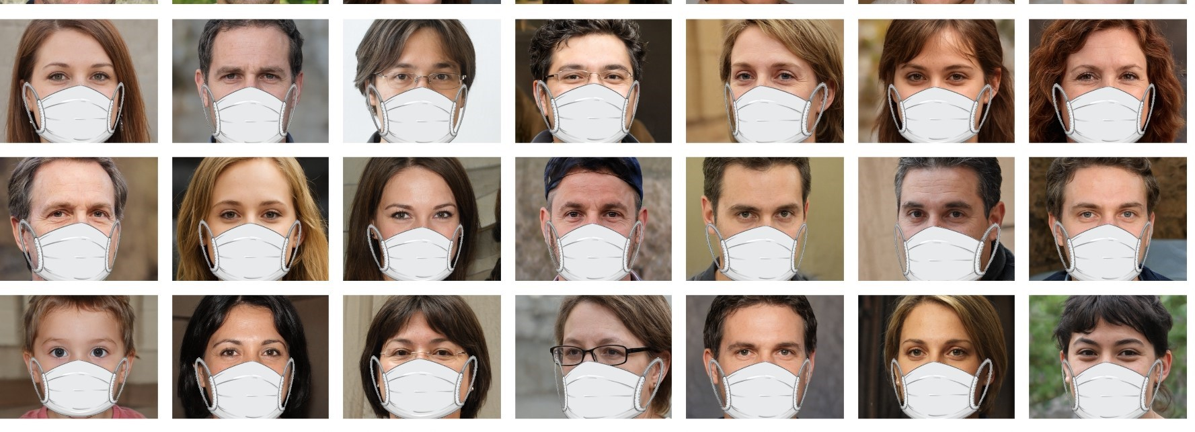
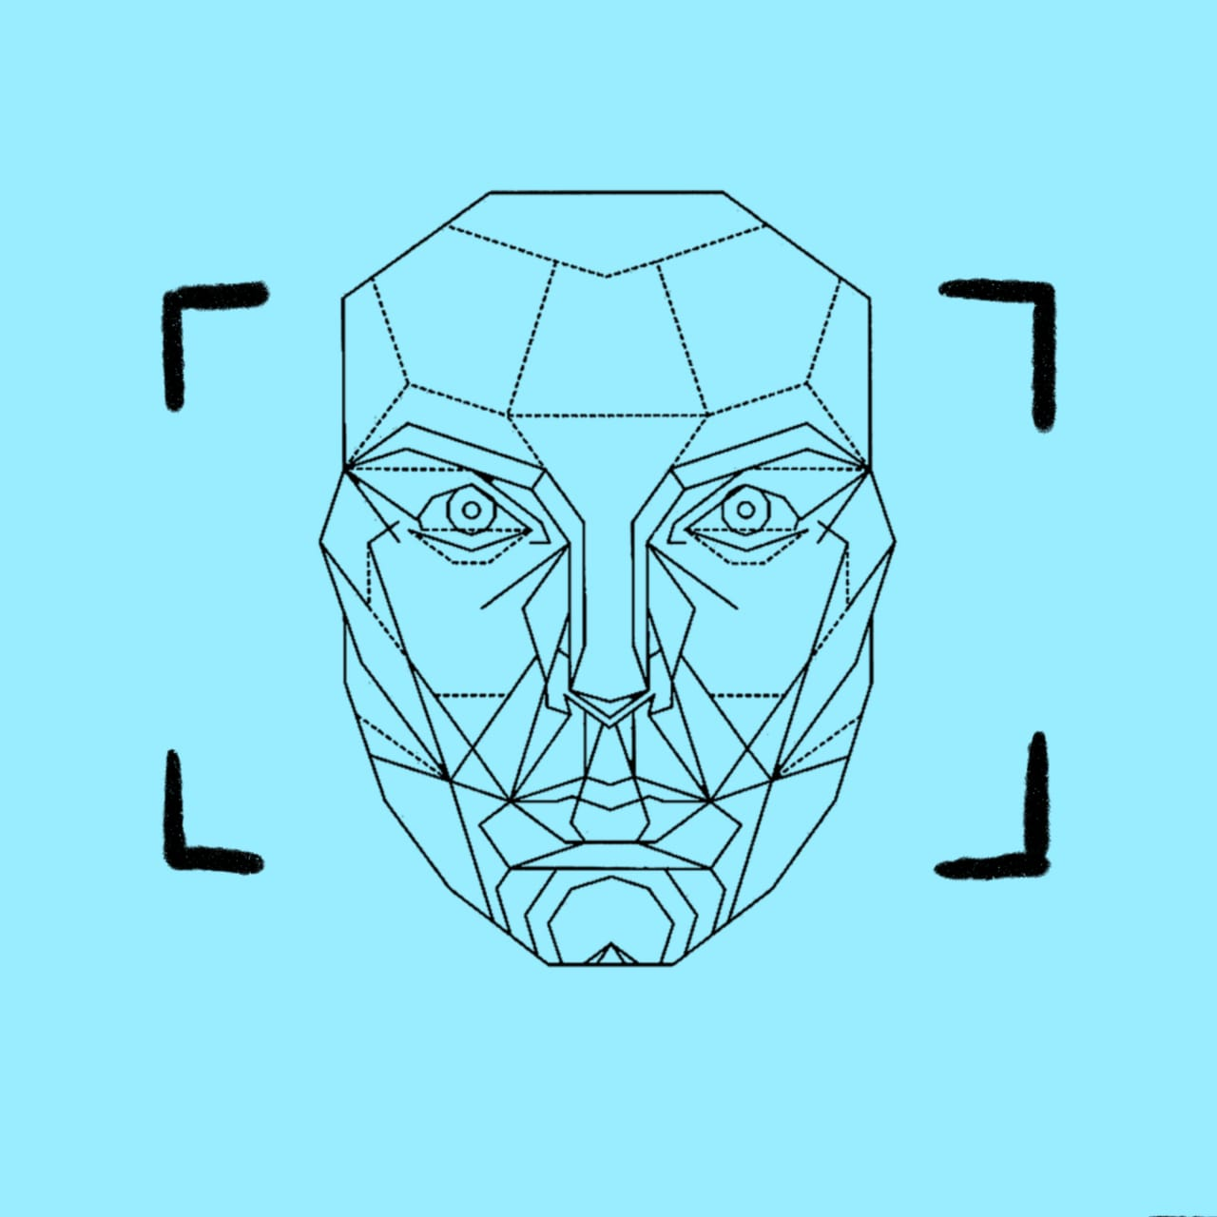

class : dataset of images of
( I ) With Mask
( II ) Without Mask

Slide 23
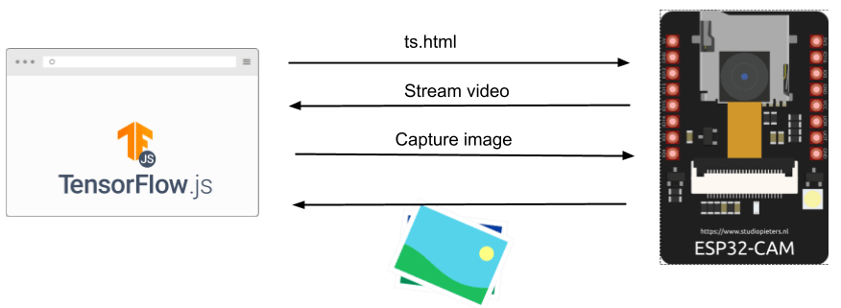
The ESP32-CAM has these tasks:
Stream video
Capture image
Provide the HTML page that will be shown in a browser that runs the Tensorflow.js machine learning models.
Arduino is uses to control servo
0 -90 Degree when mask is Detected – Door open.
Delay 5 second , then close the door 90-0 Degree.
Servo motor do not respond when no mask is detected.

Slide 24
Red LED
When camera detect No Mask
Green LED + 5V Buzzer
When Camera detect Mask
I2C 16x2 LCD to display instructions:
Please wear mask
Please Enter

Slide 25
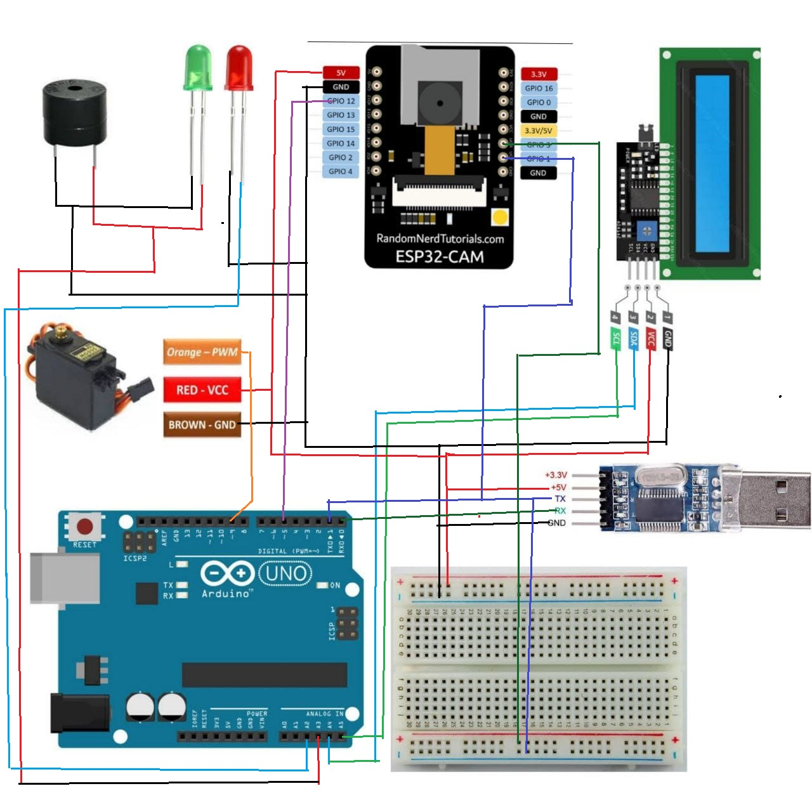
CIRCUIT DIAGRAM

Slide 26
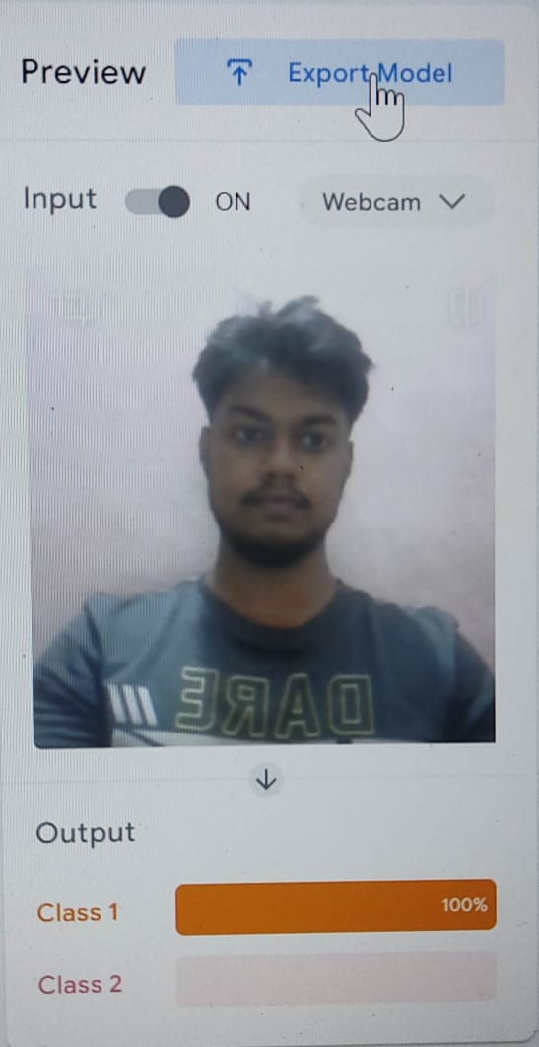
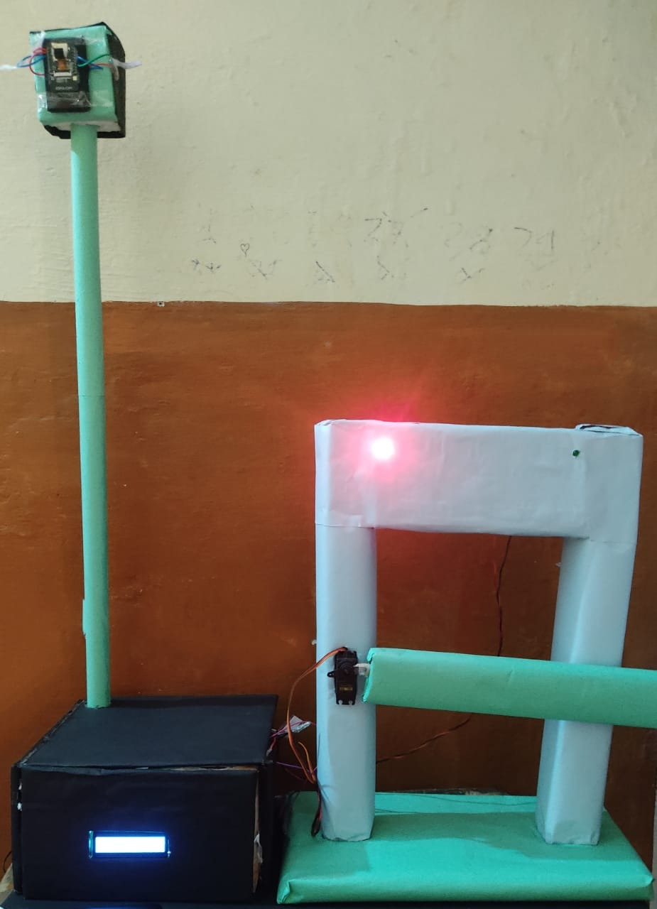
RESULTS
We have proposed a system that automatically identifies whether or not a person is wearing a face mask and if person wearing facemask door is open otherwise not.
In the first case when the person do not wear mask the door is not open and red led is ON.

Slide 27
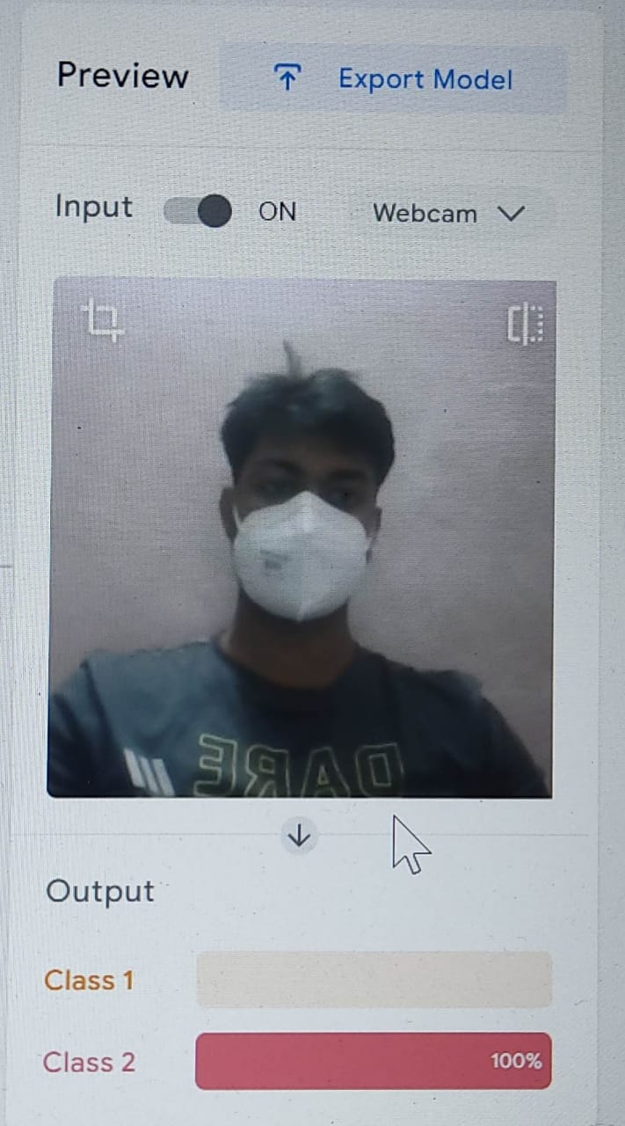
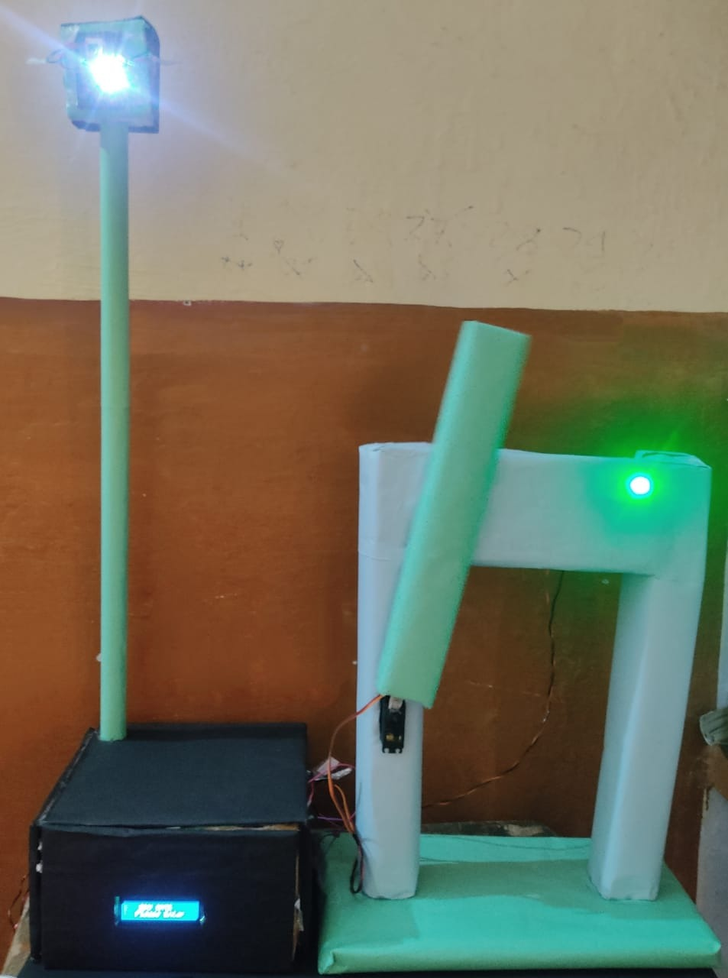
In the second case when the person wear mask the door is open and Green led & buzzer is ON.

Slide 28
Tentative cost
Understanding the importance of this project, We have tried to keep its cost to a minimum which will be around Rs.1800 - 2000.
Advantages
Public places can be monitored better.
The chances of making a mistake are negligible.
Precise monitoring and warning

Slide 29
FUTURE SCOPE
The work opens interesting future directions for researchers. Firstly, the proposed technique can be integrated into any high-resolution video surveillance devices and not limited to mask detection only.
The model can be trained and upgraded to mask datasets that include different images related to correctly/incorrectly wear mask and achieve the ultimate purpose of detecting facemask
Chemical Industry.
Paint and other hazardous Industry for Human Health.
Use for monitoring in ATM, shops, supermarket, hospitals etc.

Slide 30
REFERENCE
Bringing AI into the Classroom. https://www.actua.ca/en/bringing-ai-into the classroom/, Dec. 2019
Coronavirus 2019‐nCoV, CSSE . Coronavirus 2019‐nCoV Global Cases by Johns Hopkins CSSE.
Hui DSC, Zumla A. Severe acute respiratory syndrome: historical, epidemiologic, and clinical features. Infect Dis Clin North Am. 2019;33(4):869–889. [Crossref], [PubMed], [Web of Science ®], [Google Scholar].
Tyrrell DA, Bynoe ML. Cultivation of viruses from a high proportion of patients with colds. Lancet 1966: 1: 76–77. [PubMed] [Google Scholar].
Wang C, Horby PW, Hayden FG, et al. A novel coronavirus outbreak of global health concern. Lancet. 2020;395(10223):470–473. [Crossref], [PubMed], [Web of Science ®], [Google Scholar].

Slide 31
Webcam Pacman. https://storage.googleapis.com/tfjsexamples/webcam-transfer-learning/dist/index.html.Google Scholar
WHO Coronavirus (COVID-19) Dashboard, Jun. 2021, [online] Available: https://covid19.who.int/.
World Health Organization Coronavirus Disease 2019 (COVID-19) Situation Report-97. Available from: https://www.who.int/docs/default-source/coronaviruse/situation-reports/20200426-sitrep-97-covid-19.pdf [Google Scholar]
Wu F, Zhao S, Yu B, et al. A new coronavirus associated with human respiratory disease in China. Nature. 2020; 579(7798):265–269. [Crossref], [PubMed], [Web of Science ®], [Google Scholar]
Zhou P, Yang XL, Wang XG, et al. A pneumonia outbreak associated with a new coronavirus of probable bat origin. Nature. 2020;579(7798):270–273. [Crossref], [PubMed], [Web of Science ®], [Google Scholar]

Slide 32
THANK YOU

